Slide 1
Introduction to Software Engineering
Lectures 4 and 5

Slide 2
Boehm’s Spiral Process Model
A risk-driven software process framework (the spiral model) was proposed by Boehm (1988).
The software process is represented as a spiral, rather than a sequence of activities with some backtracking from one activity to another.

Slide 3
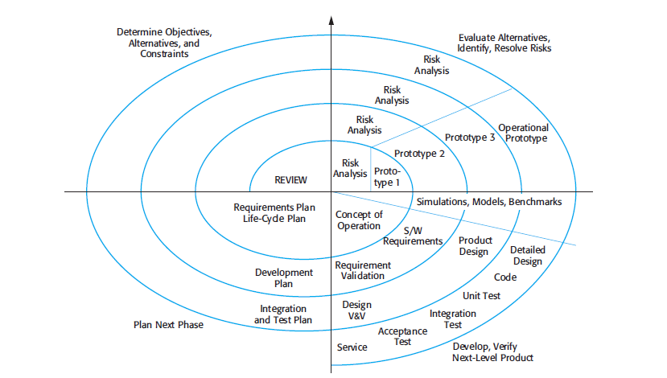
Spiral Process Model

Slide 4
Loops represent phases or versions
Each loop in the spiral represents a phase of the software process.
Thus, the innermost loop might be concerned with system feasibility, the next loop with requirements definition, the next loop with system design, and so on.
The loops may represent different versions of the same software

Slide 5
Rational Unified Process
The Rational Unified Process (RUP) (Krutchen, 2003) is an example of a modern process model that has been derived from work on the UML and the associated Unified Software Development Process.
It is a good example of a hybrid process model.
It brings together elements from all of the generic process models illustrates good practice in specification and design and supports prototyping and incremental

Slide 6
Rational Unified Process
The UP recognizes that conventional process models present a single view of the process. In contrast, the RUP is normally described from three perspectives:
A dynamic perspective, which shows the phases of the model over time.
A static perspective, which shows the process activities that are enacted.
A

Slide 7
Dynamic Perspective
The RUP is a phased model that identifies four discrete phases in the software process.
Inception
The goal of the inception phase is to establish a business case for the system.
Elaboration
The goals of the elaboration phase are to develop an understanding of the problem domain, establish an architectural framework for the system, develop the project plan, and identify key project risks.
Construction
The construction phase involves system design, programming, and testing. Parts of the system are developed in parallel and integrated during this phase
Transition
The final phase of the RUP is concerned with moving the system from the development community to the user community and making it work in a

Slide 8
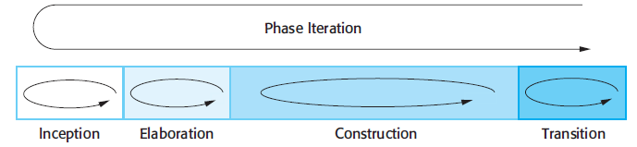
Dynamic Perspective of UP

Slide 9
Static Perspective of UP
A software engineering workflow is distributed across all UP phases.
In the context of UP, a workflow is analogous to a task set.
That is, a workflow identifies the tasks required to accomplish an important software engineering action and the work products that are produced as a consequence of successfully completing the tasks.

Slide 10
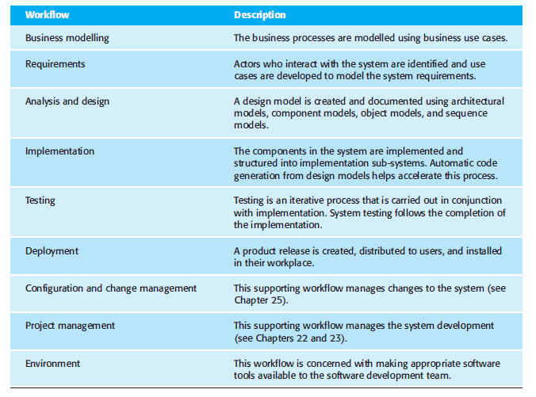
Static Perspective of Unified Process – Software Engineering Workflows

Slide 11
A practice perspective
Develop software iteratively
Plan increments of the system based on customer priorities and develop the highest-priority system features early in the development process.
Manage requirements
Explicitly document the customer’s requirements and keep track of changes to these requirements. Analyze the impact of changes on the system before accepting them.
Use component-based architectures
Structure the system architecture into components,
Visually model software Use graphical UML models to present static and dynamic views of the software.
Verify software quality Ensure that the software meets the organizational quality standards.
Control changes to software Manage changes to the software using a change management system and configuration management procedures and tools.

